Slide 1
Text Analysis
for Trump’s Twitter
Yanxiang Zhao, Jiaqi Li , Xiangui Mei, Shuyu Dong
May 29, 2019

Slide 2

01
Background & Project Goal
content
02
Data
03
Text regression
Logistic & Elastic Net
04
LDA & trading strategy
Top Topics and sector allocation
05
Q&A

Slide 3
Background & Project Goal
/01

Slide 4
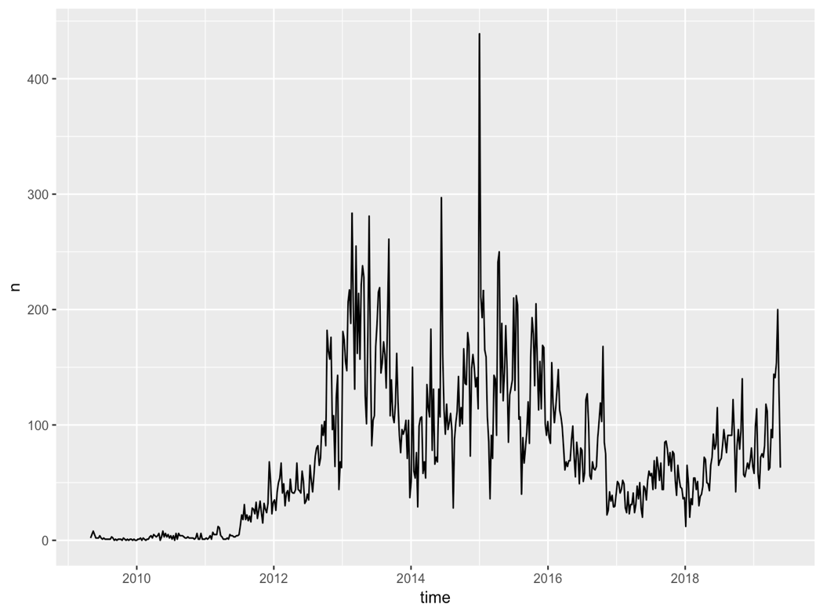
Background and Objects
Donald Trump & his tweets
Twitter:
Easy access of data
144 words limit
Exact time of each tweet
Trump:
Huge attention
Quick reaction
Huge amount
Focused(limited) vocabulary
Elected president

Slide 5
Data
/02

Slide 6
Data Processing
Raw data:
All trump’s tweets including those deleted with exact time stamp and the hashtag (from twitter)
Daily return of S&P 500 (CRSP)
Daily return of S&P 11 sectors (Yahoo finance)
Data cleaning:
Text
Remove hashtag and url
Extract the text
Delete stop words and the non-significant word
Date stamp
Tweets after 4pm belongs to the next day
Weekend and holiday tweets get delayed to the next trading day
Combine with the stock market return

Slide 7
Text Regression
/03
Logistic Regression & Elastic Net

Slide 8
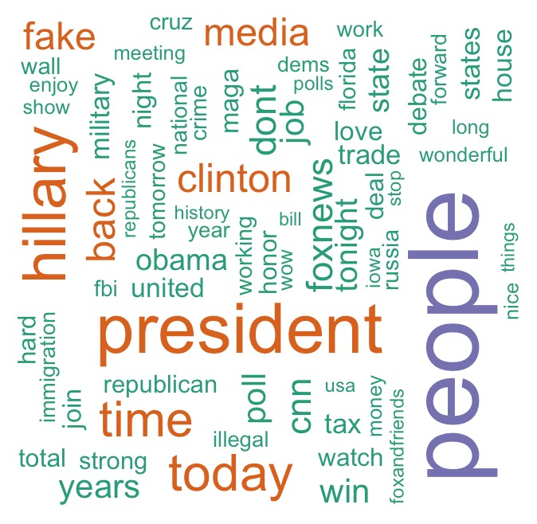
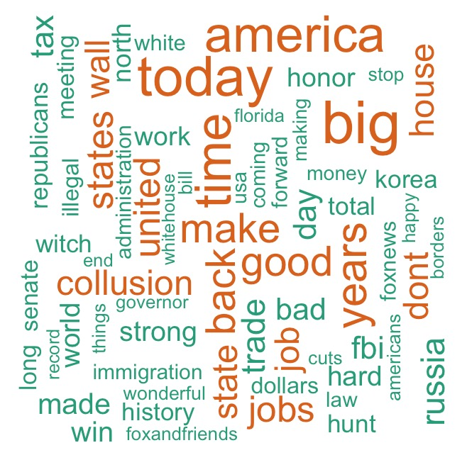
Text Analysis
Word cloud after announcing candidacy
After being elected as president
Keyword
keywords: president, Hillary, Clinton, fox news
keywords: collusion, immigration, illegal, wall

Slide 9
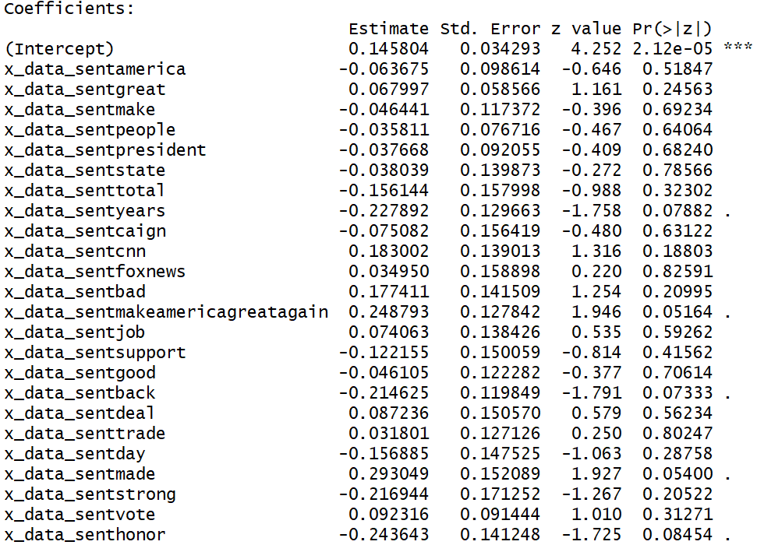
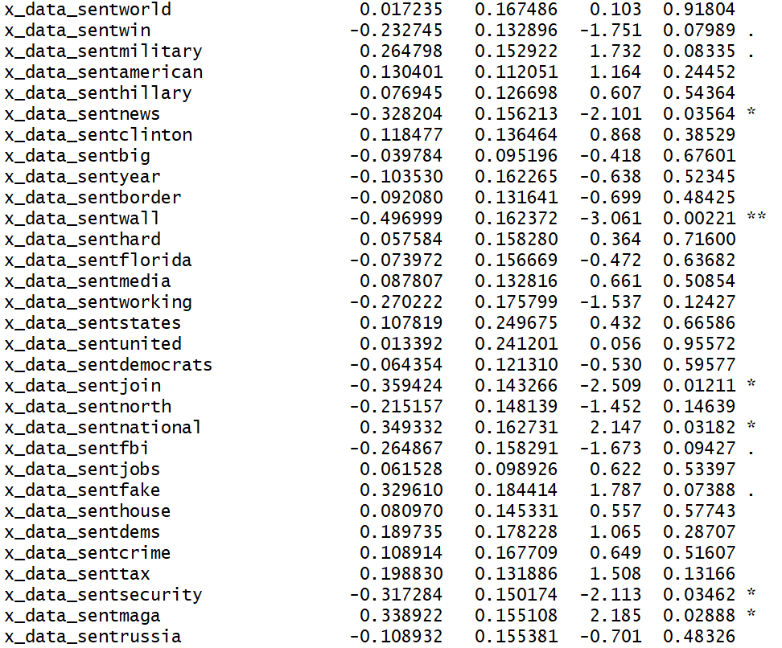
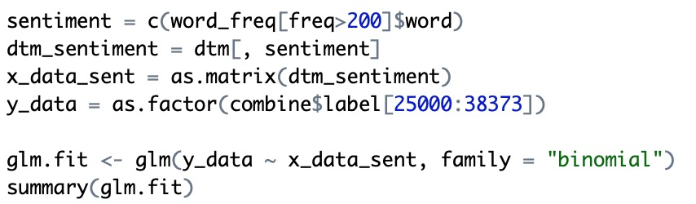
Logistic Regression
Statistically significant words after announcing candidacy:
Make American great again; border; military;
win; democratic; FBI; national; security….

Slide 10
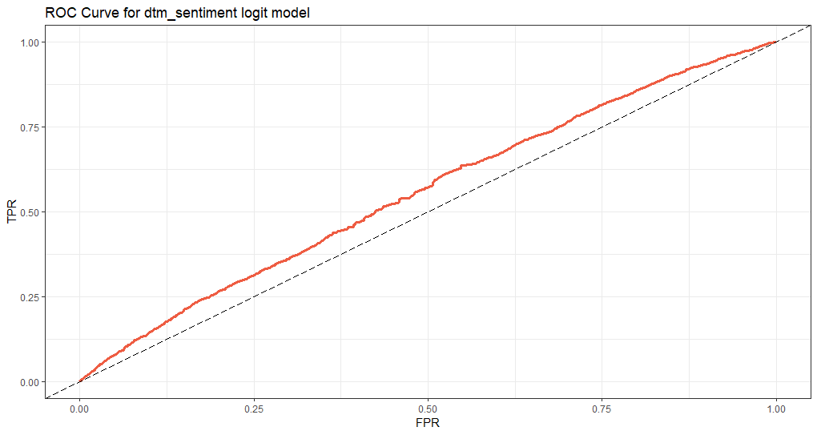
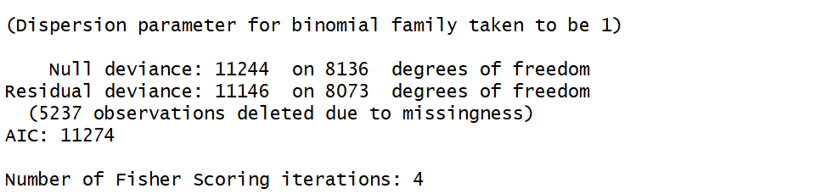
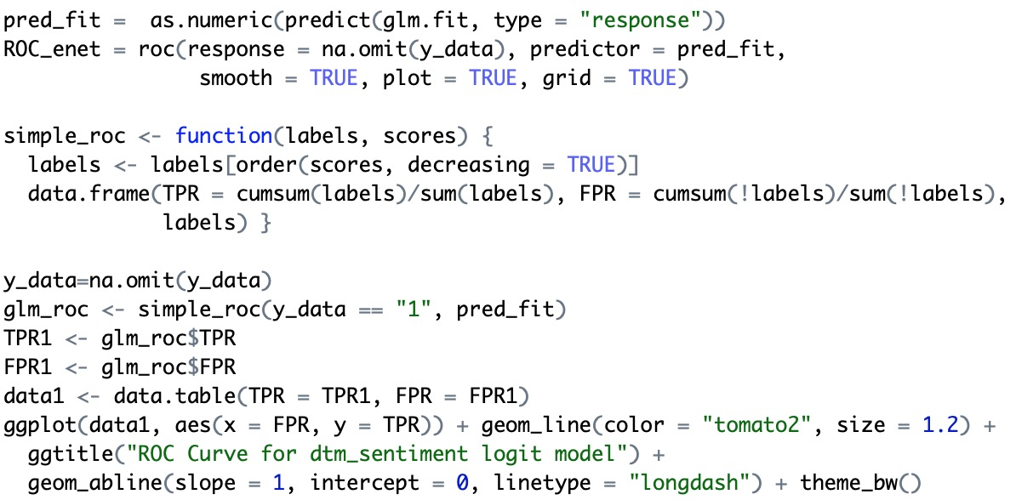
Results Analysis (AIC and ROC Curve)
AIC : very large
ROC Curve
Slightly better than random, not very significant.

Slide 11
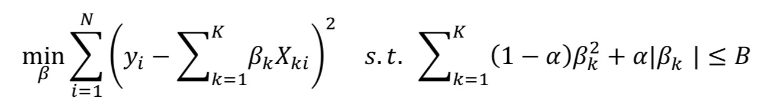
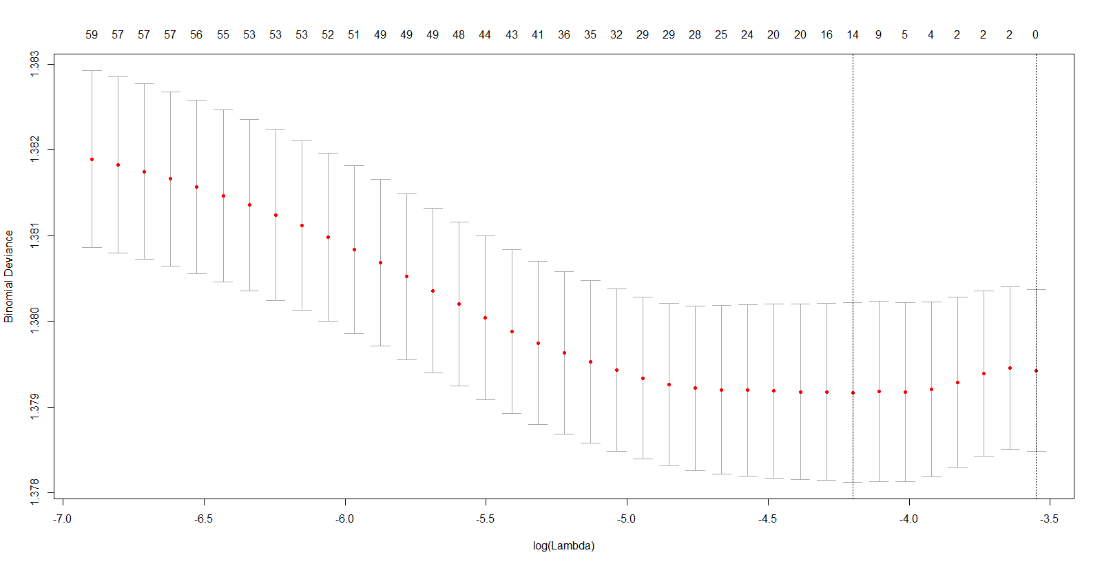
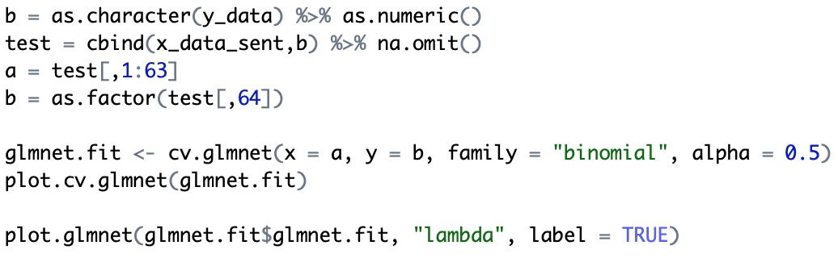
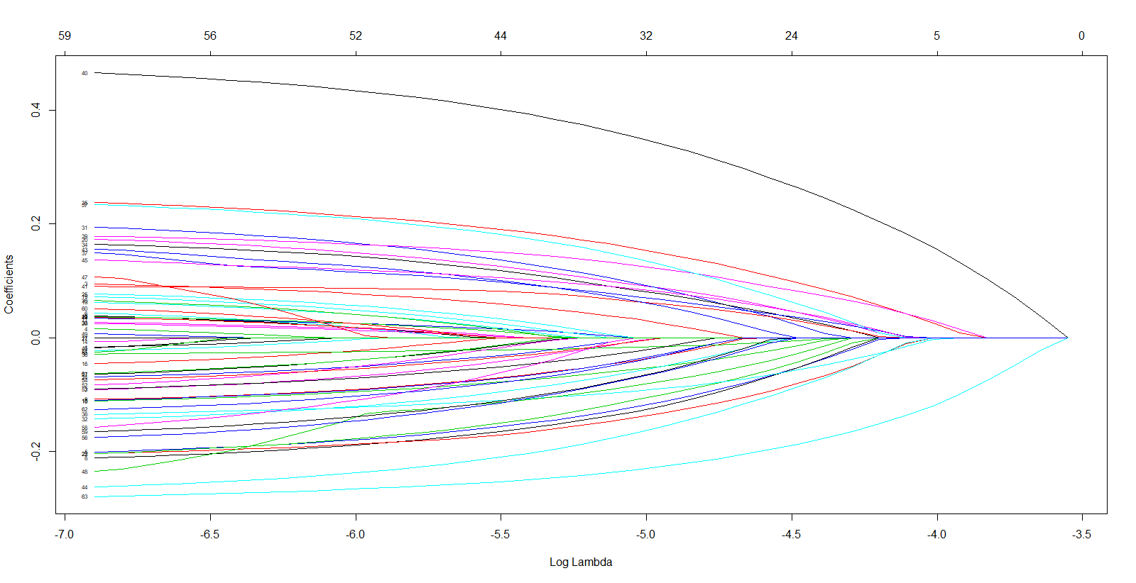
Elastic Net

Slide 12
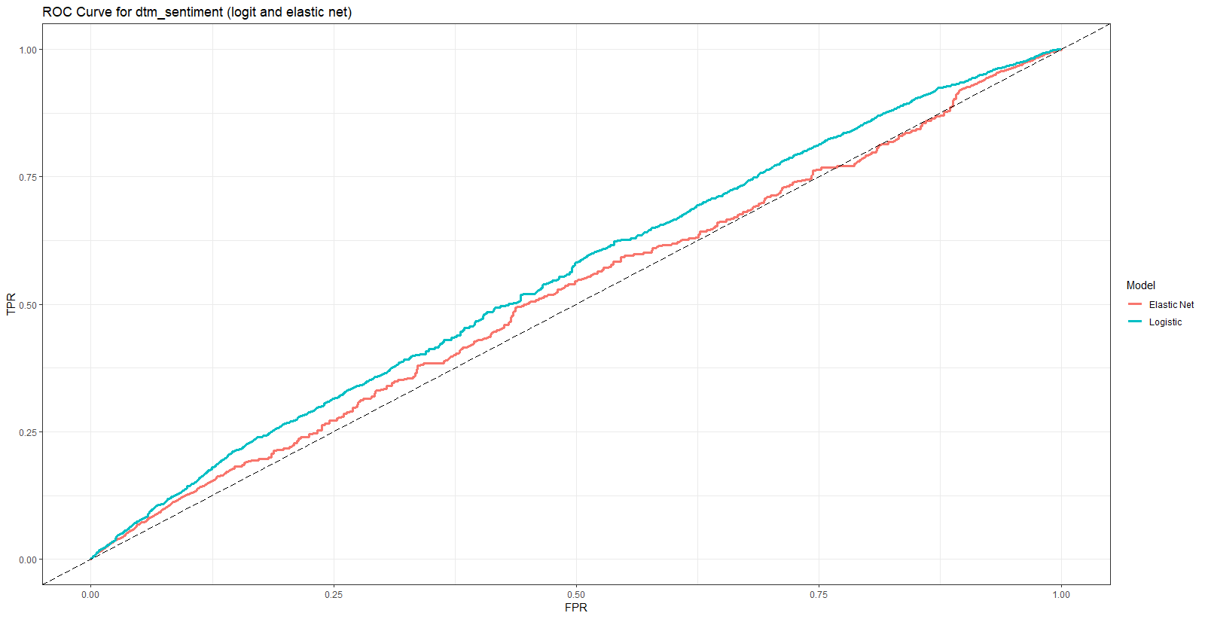
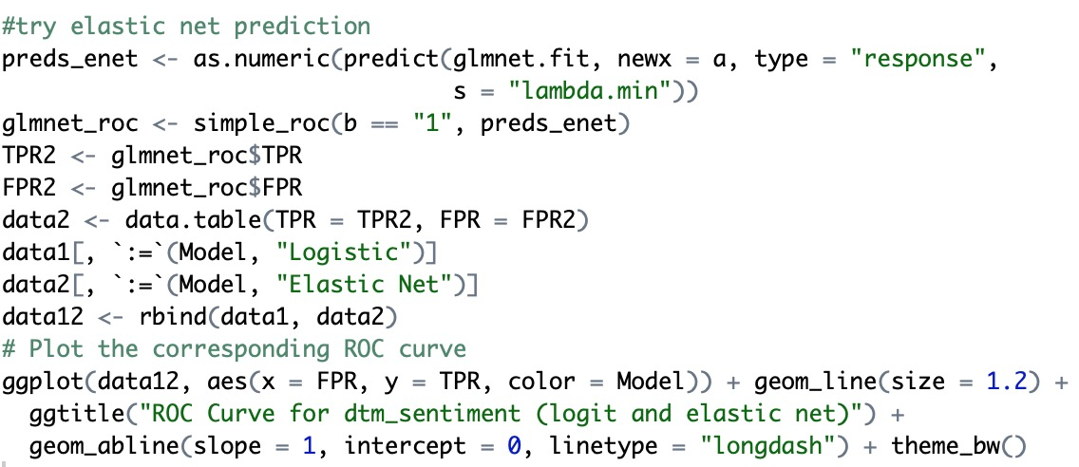
Results Analysis (ROC Curve)
ROC Curve
Even worse than logistic regression.

Slide 13
LDA & trading strategy
/04
Top topics of President Trump’s tweets and their effects on market and sector returns.

Slide 14

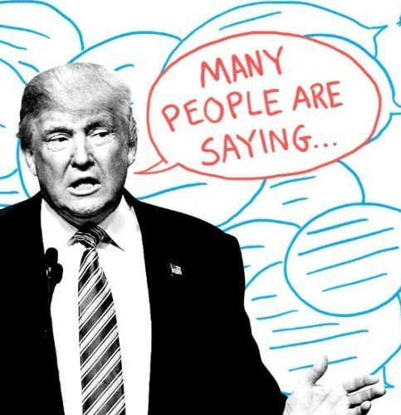




Top 5 Topics and Keywords from LDA
1. Asia-Pacific
us / trade / jobs / great / china /
years / korea / north / many / country
Domestic Affairs
great / honor / president / America / people / day / whitehouse / first / us / american
2. Fake News
news/fake/media/great/people/
just/president/never/cnn/many
Homeland Security
border / great / democrats / vote / people / country / wall / crime / get / security
3. Russian Interference
collusion / fbi / Hillary / witch / hunt /
mueller / russia / democrats / president / clinton

Slide 15
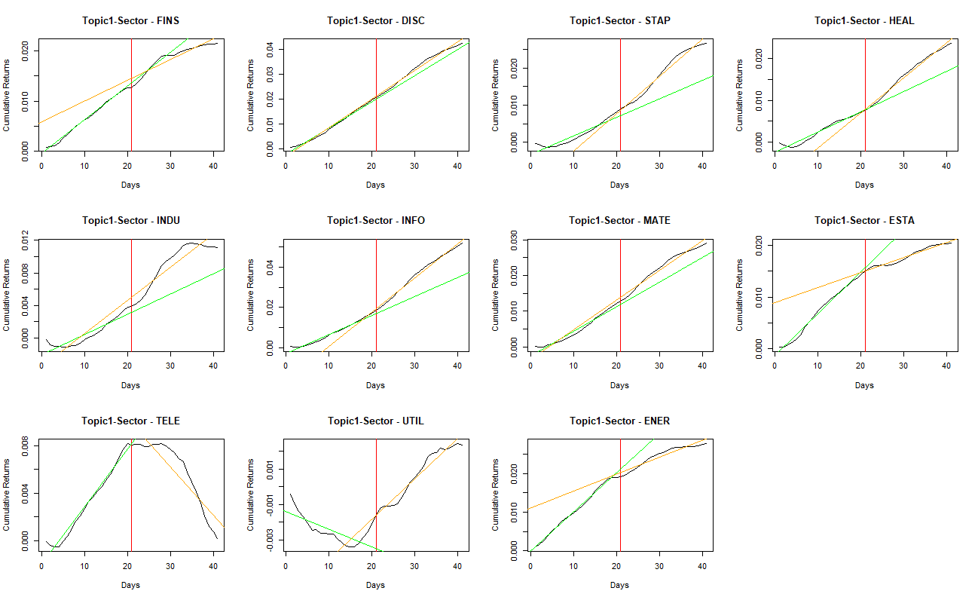
Trend Analysis – Topic 1 tweets effects on sectors
11 S&P 500 sectors
Event study:
Use Trump’s tweet posting as cutoff
Compare 20-day cumulative returns before and after the cutoff.

Slide 16
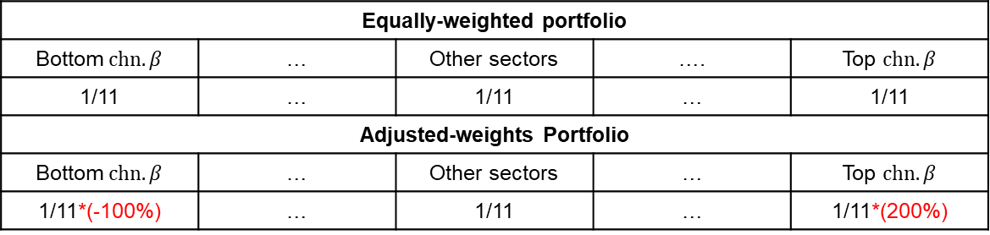
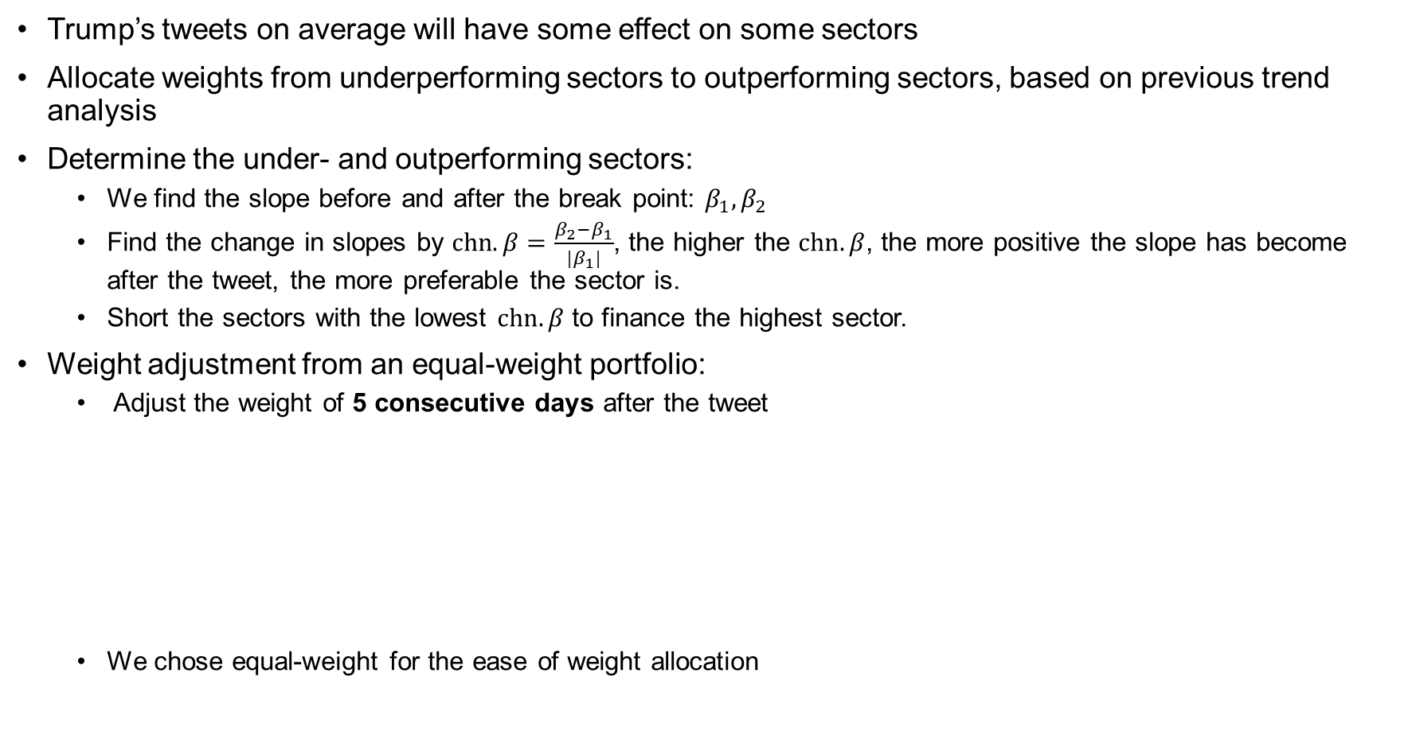
Sector Allocation after Trump’s tweet
Trump’s tweets on average will have some effect on some sectors
Allocate weights from underperforming sectors to outperforming sectors, based on previous trend analysis
Determine the under- and outperforming sectors:
We find the slope before and after the break point: $β_{1}, β_{2}$
Find the change in slopes by $chn.β=\frac{β_{2}−β_{1}}{{|β}_{1}|}$, the higher the $chn.β$, the more positive the slope has become after the tweet, the more preferable the sector is.
Short the sectors with the lowest $chn.β$ to finance the highest sector.
Weight adjustment from an equal-weight portfolio:
Adjust the weight of 5 consecutive days after the tweet
We chose equal-weight for the ease of weight allocation
Equally-weighted portfolio
Bottom $chn.β$ | … | Other sectors | …. | Top $chn.β$
1/11 | … | 1/11 | … | 1/11
Adjusted-weights Portfolio
Bottom $chn.β$ | … | Other sectors | … | Top $chn.β$
1/11*(-100%) | … | 1/11 | … | 1/11*(200%)

Slide 17
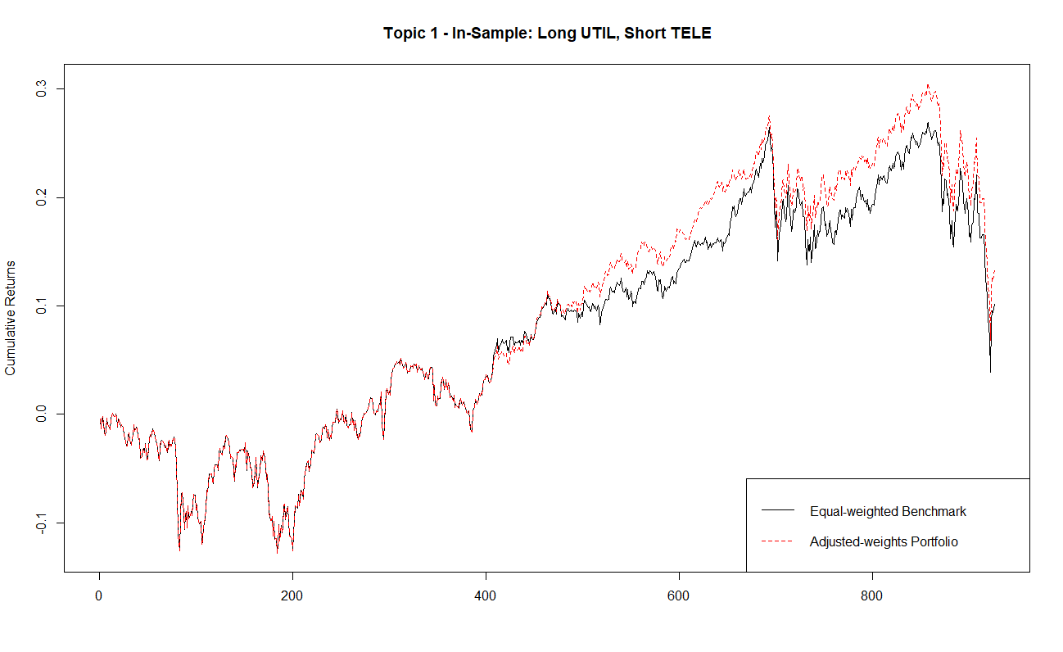
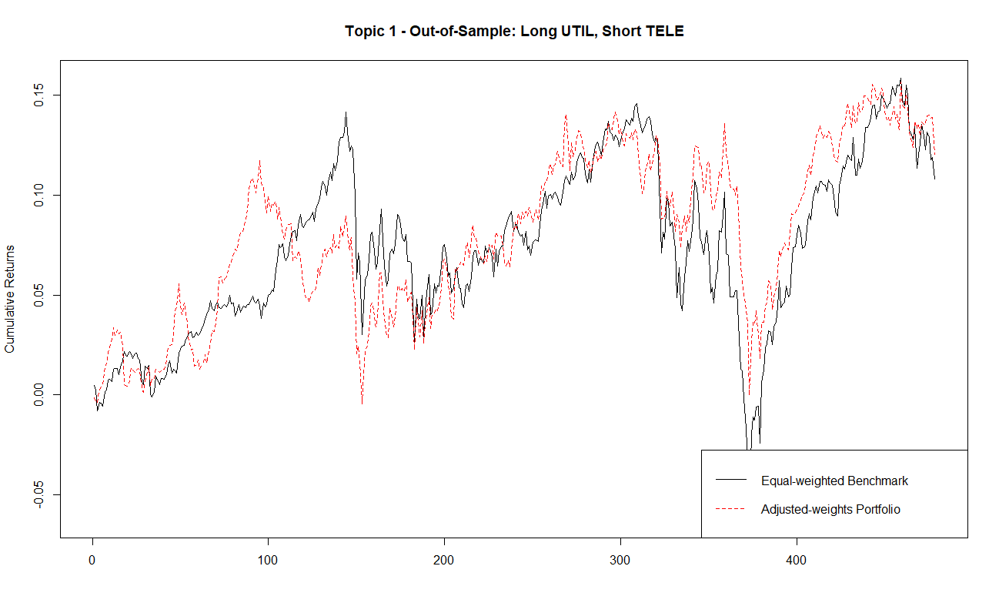
Sector Allocation – Topic 1, In-sample vs. Out-of-sample
From 2016/11/06 to 2017/06/30
From 2017/06/30 to 2019/05/24
 | Benchmark | Adj. Portfolio
Ann. Mean | 0.03422262 | 0.04142439
Ann. SD | 0.1256202 | 0.1224488
SR | 0.2724293 | 0.3382998
Skewness | -0.4255131 | -0.3447671
Ex. Kurtosis | 4.101629 | 4.154757
 | Benchmark | Adj. Portfolio
Ann. Mean | 0.06176828 | 0.06620631
Ann. SD | 0.1243405 | 0.1127184
SR | 0.4967671 | 0.5873604
Skewness | -0.4804318 | -0.342091
Ex. Kurtosis | 4.311413 | 2.548067

Slide 18
Thanks. Any Questions?
/05

Slide 19
Appendix
/06

Slide 20
Top 5 Topics Sample Tweet
Topic 2
Topic 3
Topic 5
Topic 1
Topic 4
The Woodward book is a Joke just another assault against me in a barrage of assaults using now disproven unnamed and anonymous sources Many have already come forward to say the quotes by them like the book are fiction Dems cant stand losing Ill write the real book
The Rigged Witch Hunt originally headed by FBI lover boy Peter S for one year now Angry Democrats should look into the missing DNC Server Crooked Hillarys illegally deleted Emails the Pakistani Fraudster Uranium One Podesta so much more It’s a Democrat Con Job
LAST thing the Make America Great Again Agenda needs is a Liberal Democrat in Senate where we have so little margin for victory already The PelosiSchumer Puppet Jones would vote against us 100 of the time Hes bad on Crime Life Border Vets Guns Military VOTE ROY MOORE
July is just the ninth month since 1970 that unemployment has fallen below 4 Our economy has added 37 million jobs since I won the Election 41 GDP More than 4 million people have received a pay raise due to tax reform 400 Billion brought back from overseas FoxNews
Just finished briefing POTUS VP WhiteHouse homeland security team on Hurricane Florence w FEMABrock The entire federal gov is working closely with our state local partners on the response Importantly this storm is not over major flooding could take place all week

Slide 21
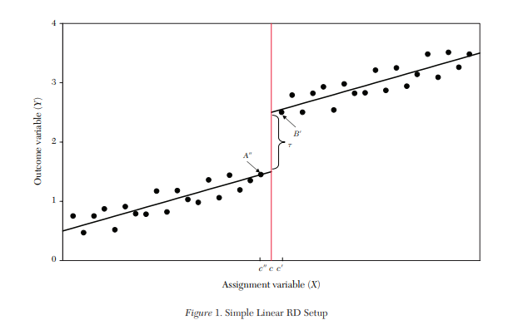
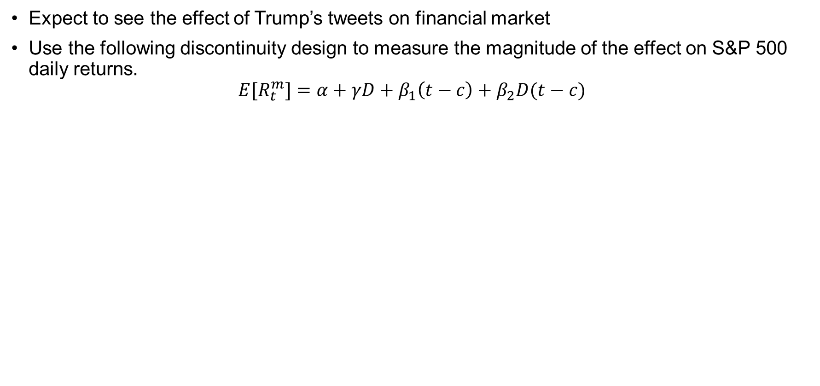
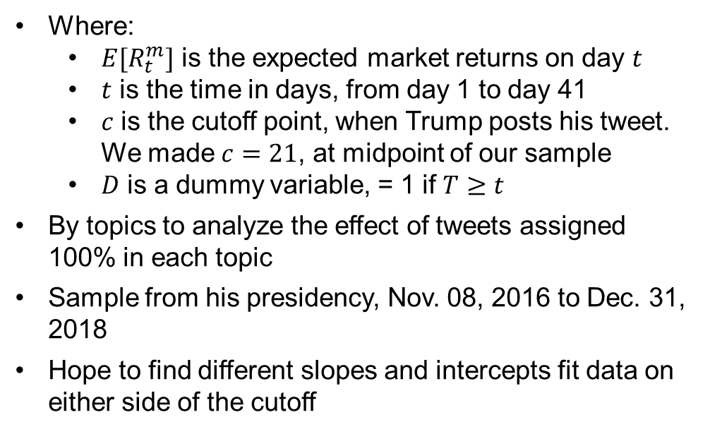
Regression Discontinuity Design
Expect to see the effect of Trump’s tweets on financial market
Use the following discontinuity design to measure the magnitude of the effect on S&P 500 daily returns.
$${E[R}_{t}^{m}]=α+γD+β_{1}\left(t−c\right)+β_{2}D(t−c)$$
Where:
${E[R}_{t}^{m}]$ is the expected market returns on day $t$
$t$ is the time in days, from day 1 to day 41
$c$ is the cutoff point, when Trump posts his tweet. We made $c=21$, at midpoint of our sample
$D$ is a dummy variable, = 1 if $T≥t$
By topics to analyze the effect of tweets assigned 100% in each topic
Sample from his presidency, Nov. 08, 2016 to Dec. 31, 2018
Hope to find different slopes and intercepts fit data on either side of the cutoff

Slide 22
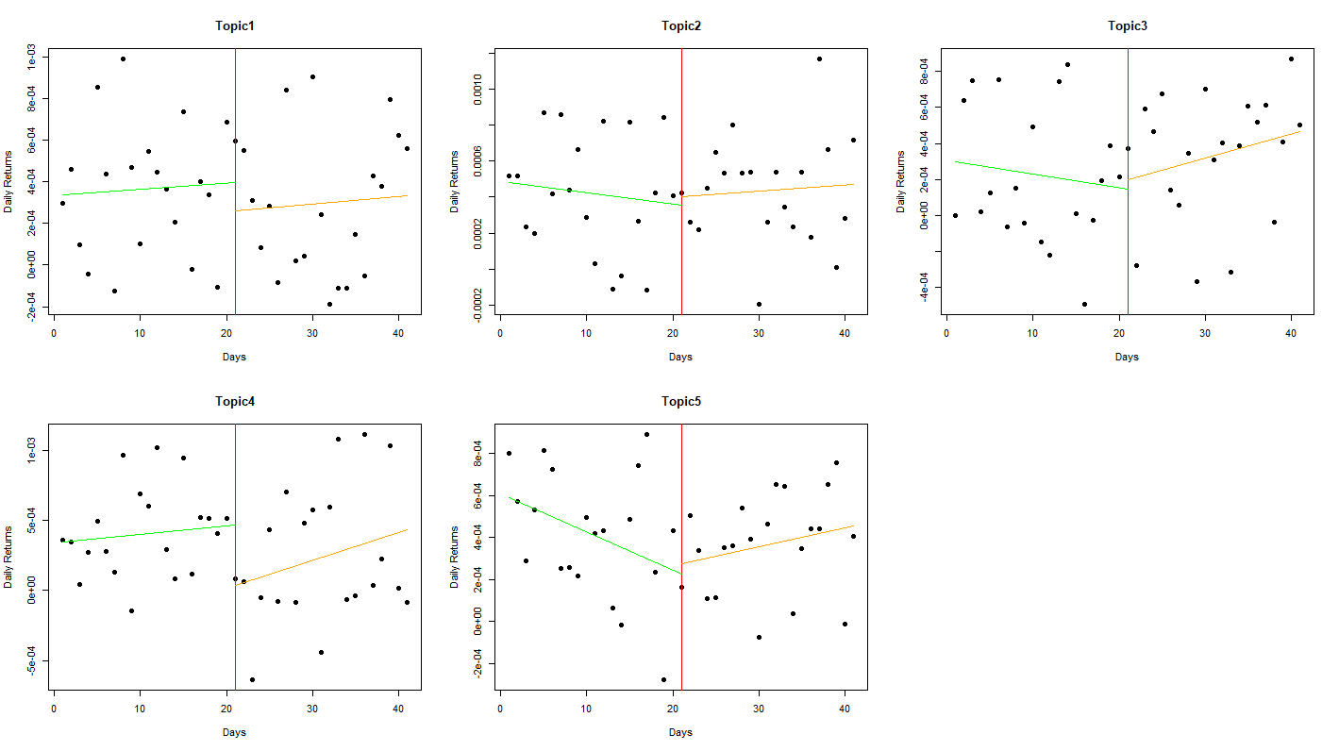
Regression Discontinuity Design, cont.
Highly scattered daily returns
Magnitude of difference is economically insignificant

Slide 23
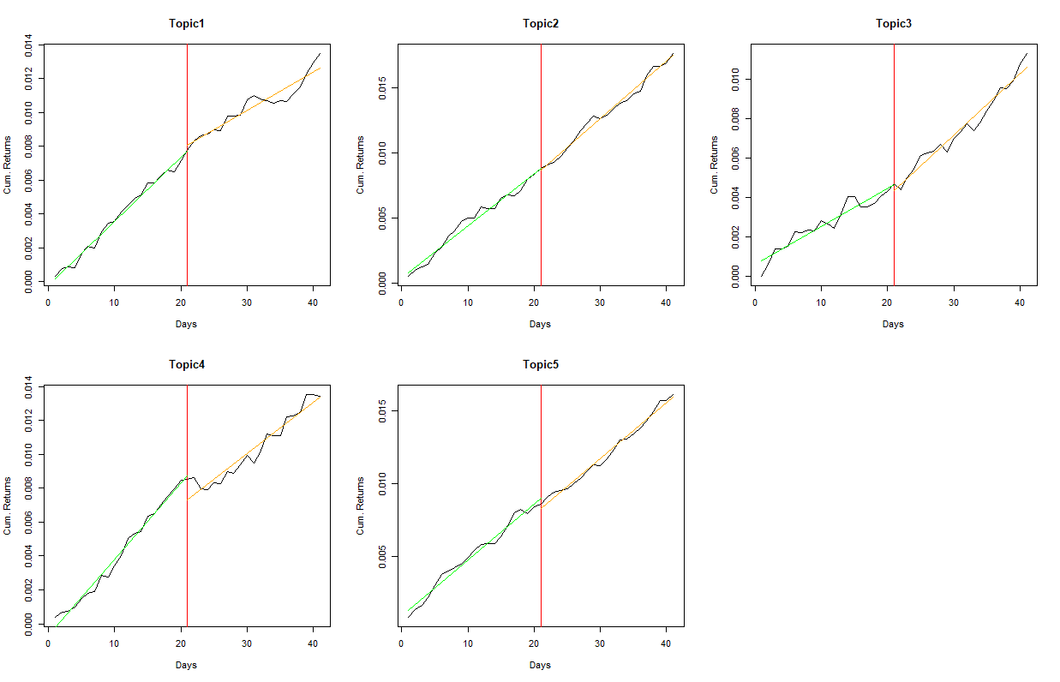
Trend Analysis
Instead of daily returns, try to understand the 20-day cumulative returns before and after the tweet

Slide 24
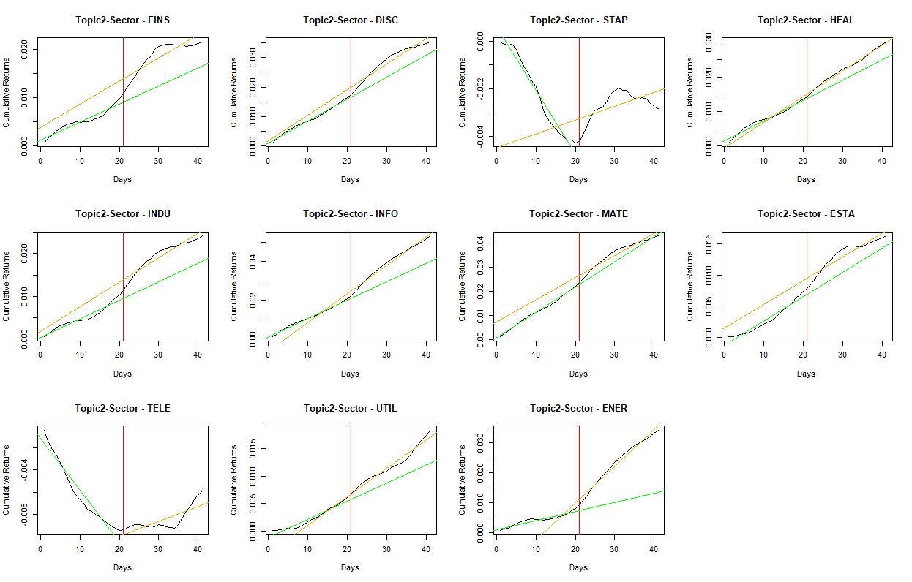
Trend Analysis – Topic 2 tweets effects on sectors

Slide 25
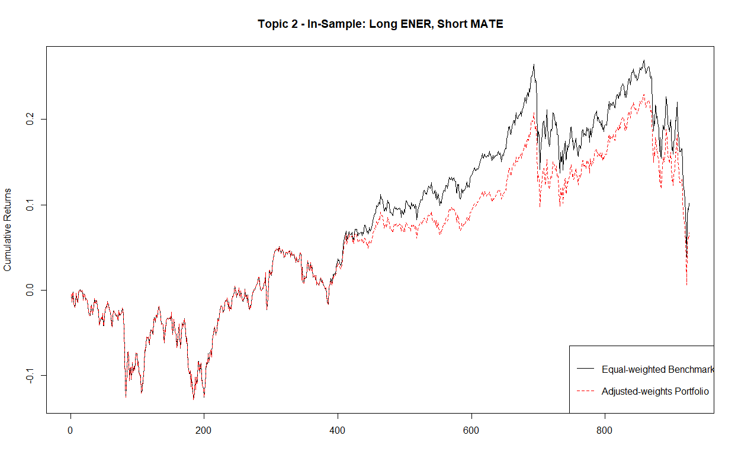
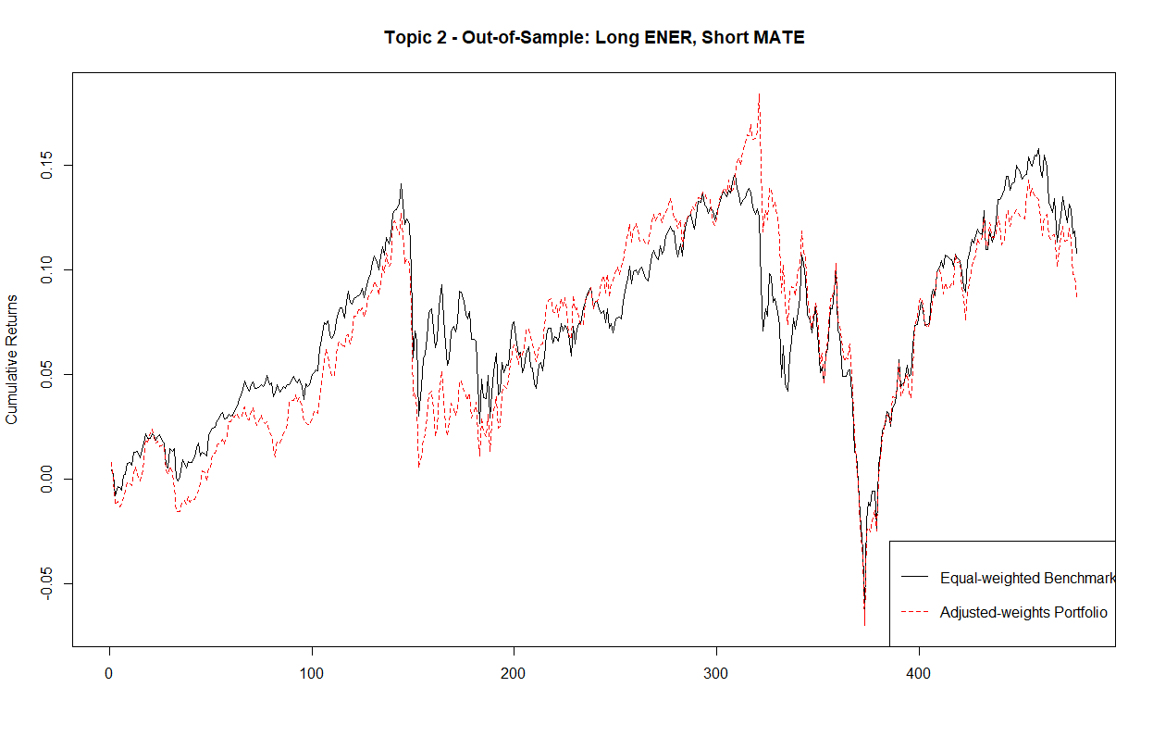
Sector Allocation – Topic 2, In-sample vs. Out-of-sample
From 2016/11/06 to 2017/06/30
From 2017/06/30 to 2018/05/24

Slide 26
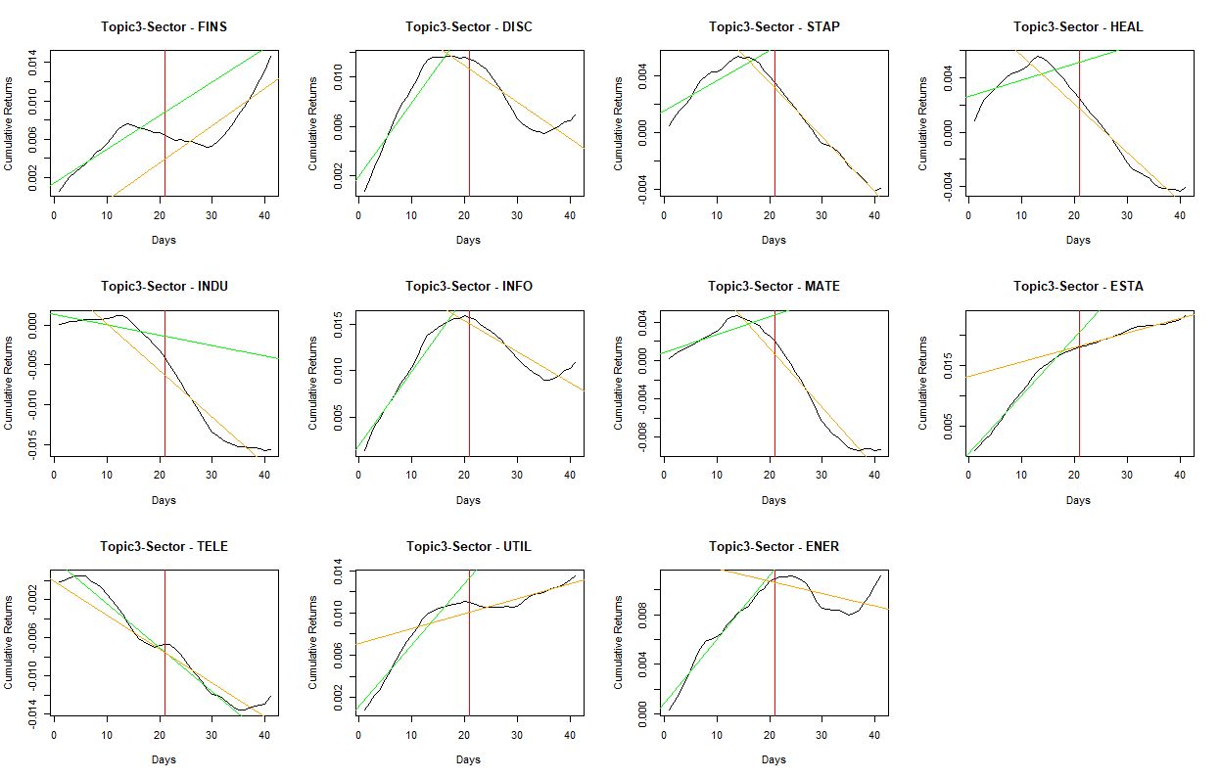
Trend Analysis – Topic 3 tweets effects on sectors

Slide 27

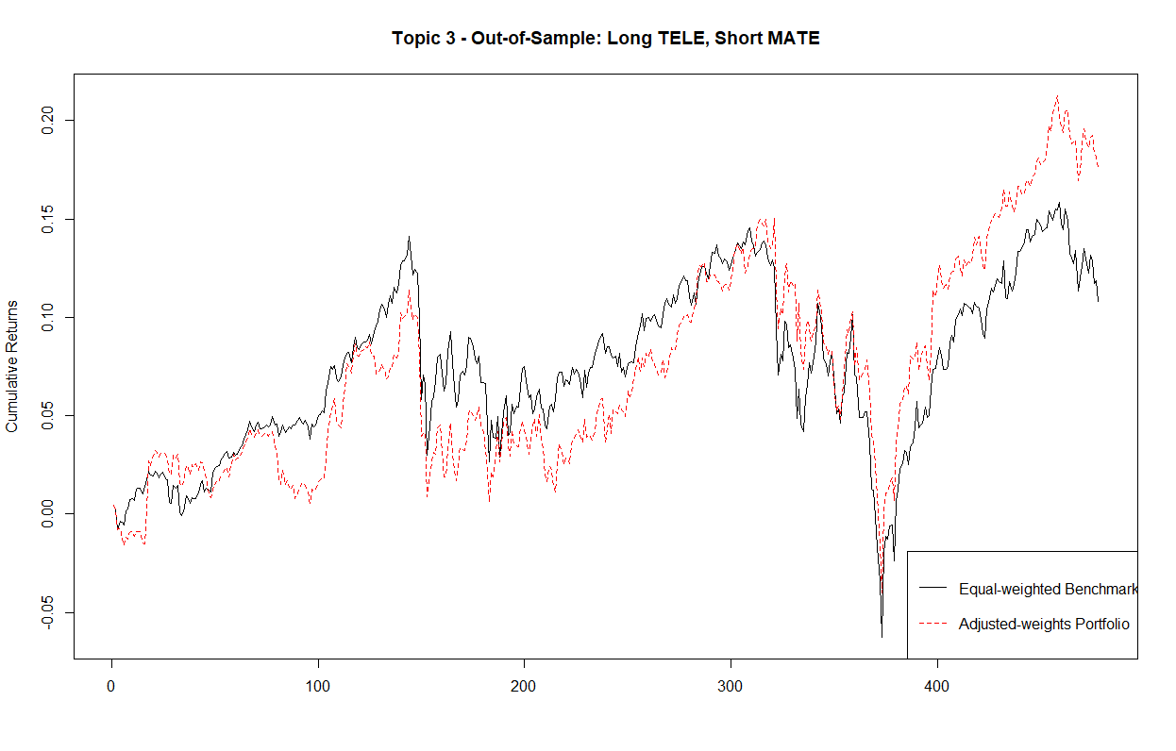
Sector Allocation – Topic 3, In-sample vs. Out-of-sample
From 2016/11/06 to 2017/06/30
From 2017/06/30 to 2018/05/24

Slide 28
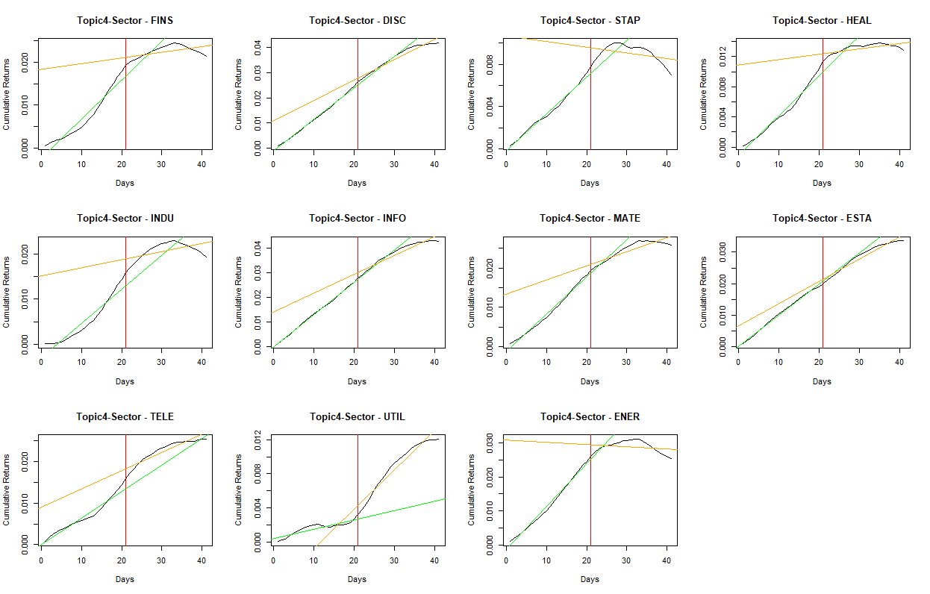
Trend Analysis – Topic 4 tweets effects on sectors

Slide 29
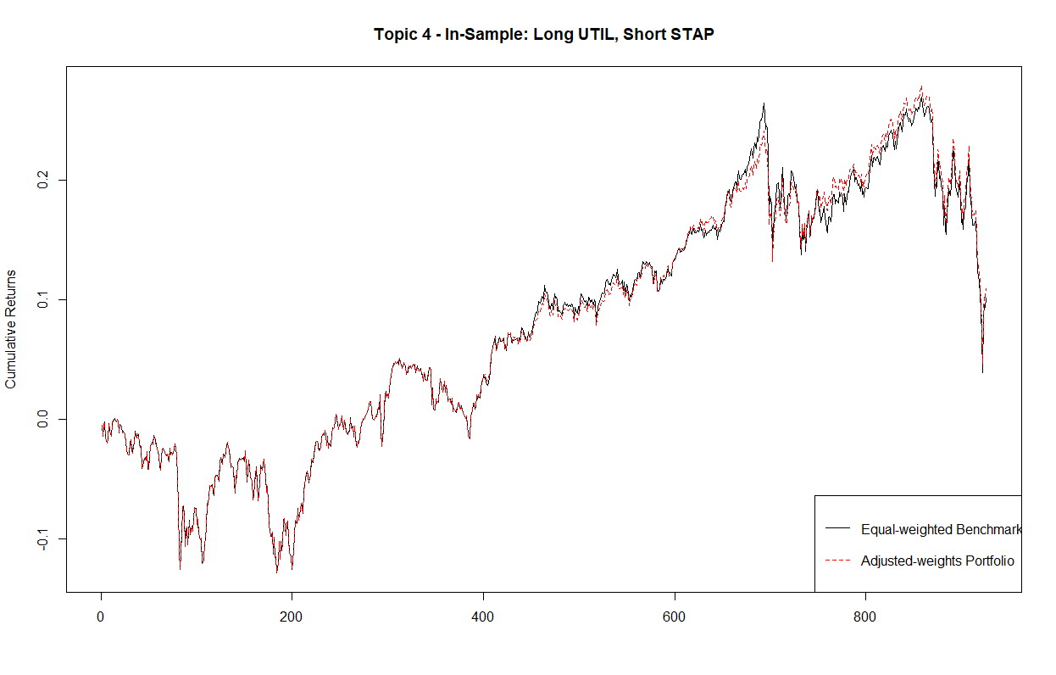
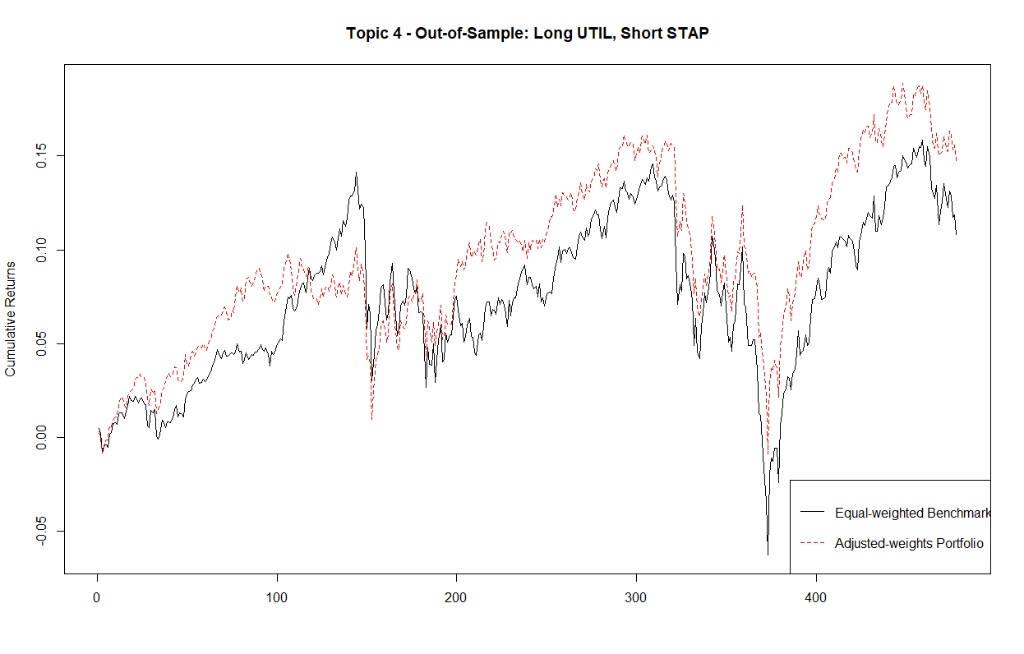
Sector Allocation – Topic 4, In-sample vs. Out-of-sample
From 2016/11/06 to 2017/06/30
From 2017/06/30 to 2018/05/24

Slide 30
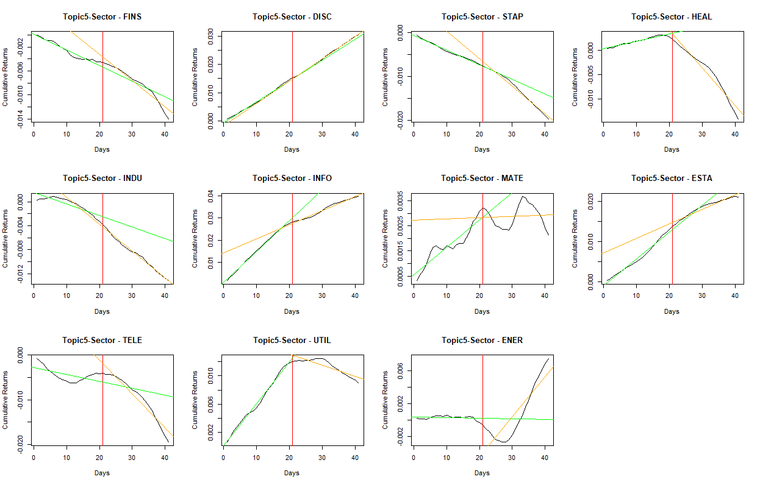
Trend Analysis – Topic 5 tweets effects on sectors

Slide 31
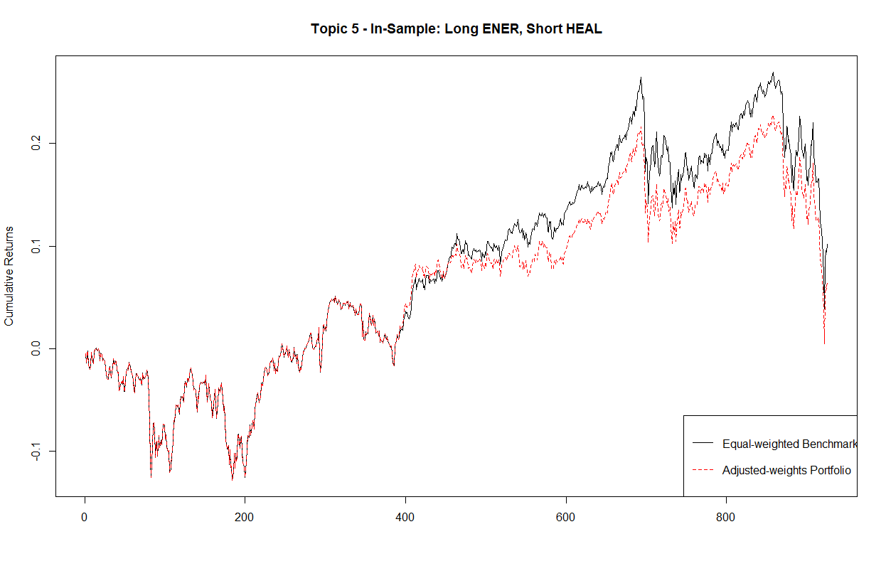
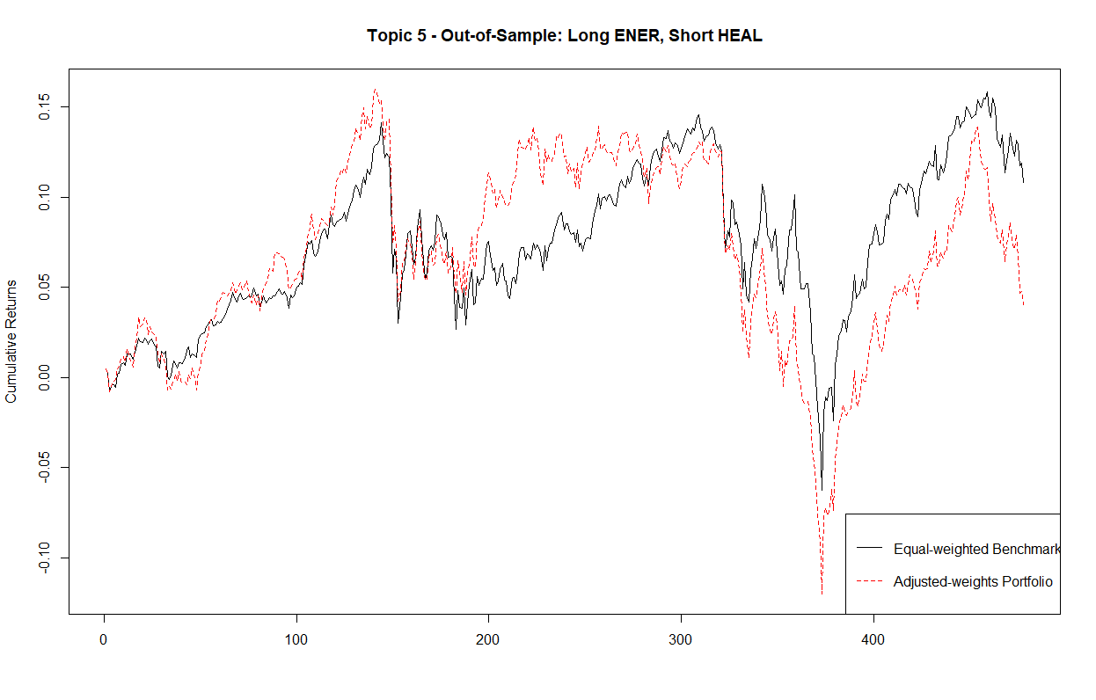
Sector Allocation – Topic 5, In-sample vs. Out-of-sample
From 2016/11/06 to 2017/06/30
From 2017/06/30 to 2018/05/24

